Slide 1


ONLINE SHOPPING MANAGEMENT
BY
S.VIGNESH,
A.GAGANESH,
V.RAHUL

Slide 2
import java.util.Scanner;
public class OnlineShoppingSystem {
public static void main(String[] args) {
Scanner scanner = new Scanner(System.in);
String[] products = {"Laptop", "Phone", "Headphones"};
double[] prices = {800.0, 500.0, 100.0};
System.out.print("Enter your username: ");
String username = scanner.nextLine();
System.out.println("Available products:");

Slide 3
for (int i = 0; i < products.length; i++) {
System.out.println((i + 1) + ". " + products[i] + " ($" + prices[i] + ")");
}
System.out.print("Enter the product number you want to buy: ");
int productNumber = scanner.nextInt();
if (productNumber >= 1 && productNumber <= products.length) {
String selectedProduct = products[productNumber - 1];
double productPrice = prices[productNumber - 1];
System.out.println("Added " + selectedProduct + " to your cart.");
System.out.println("Total price: $" + productPrice);

Slide 4
} else {
System.out.println("Invalid product number. Please try again.");
}
scanner.close();
}
}

Slide 5
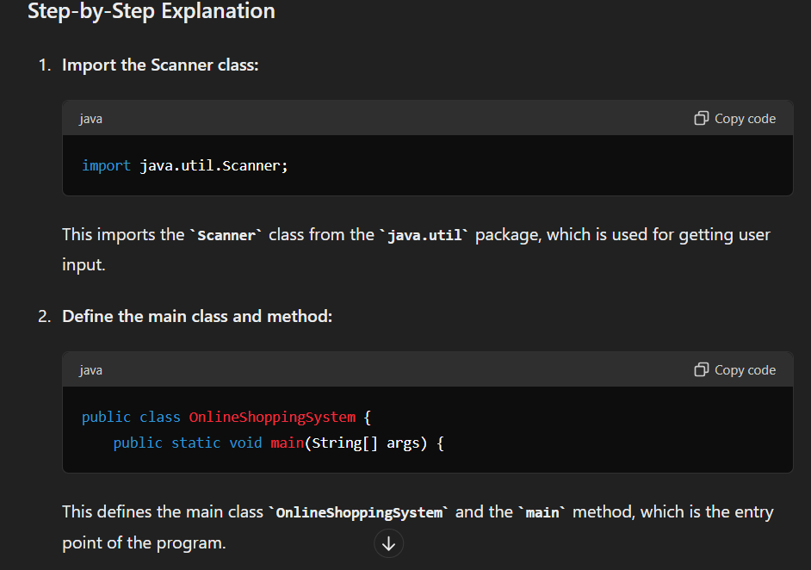

Slide 6
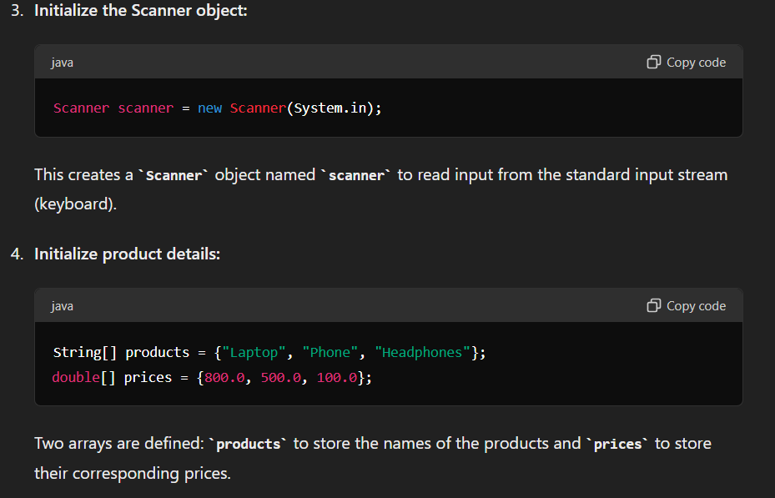

Slide 7
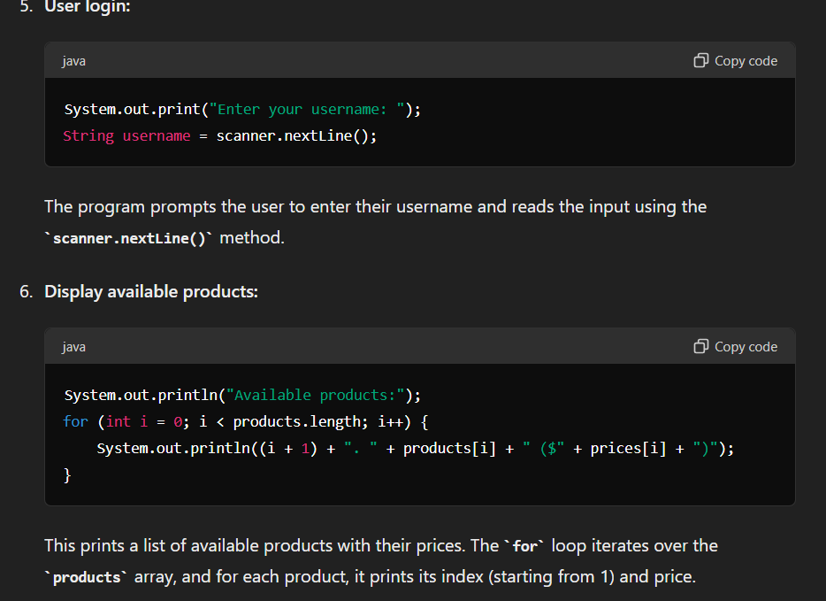

Slide 8
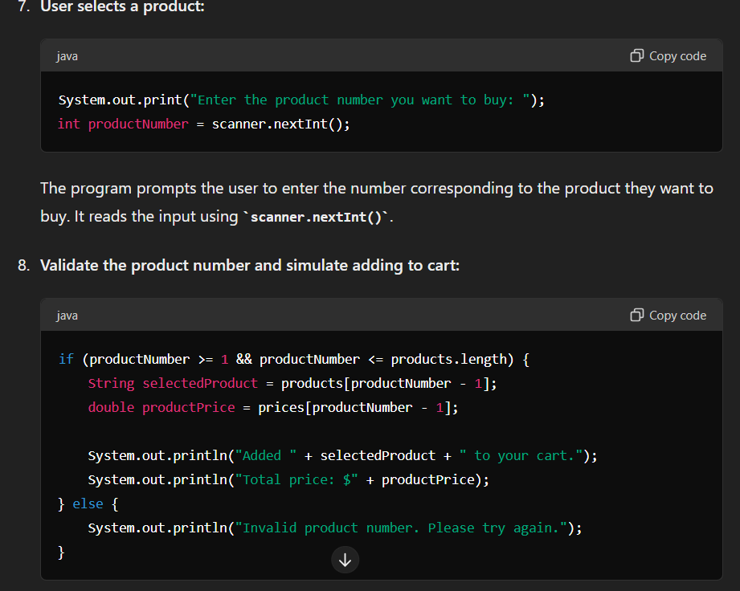

Slide 9
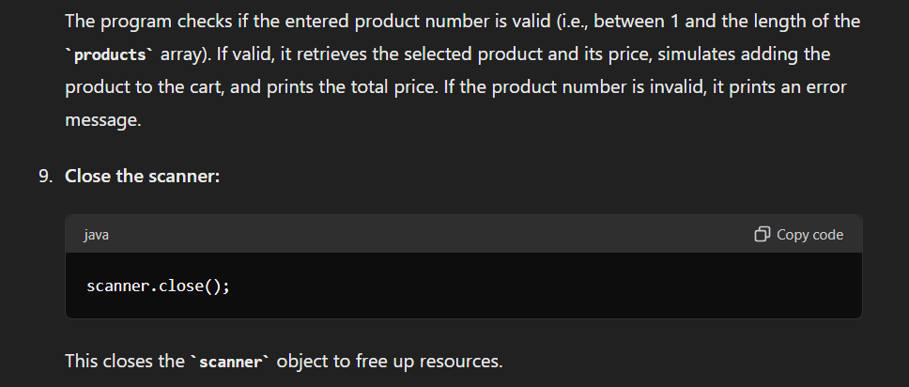

Slide 10
THANK YOU

